Slide 1
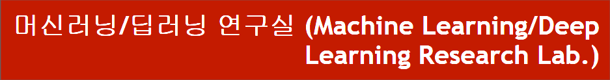
Code Analysis of DARTS
동서대학교 대학원 컴퓨터공학과
Jie Yong Shin,
Dae-Ki, Kang , Prof (advisor)
2022.02.03
Notes:
1

Slide 2
CONTENTS
1. Summary
2. Approximation
3. Code Analysis
4. Problems Discussed
5. Research Progress
6. Conclusion and Discussion
Notes:
2

Slide 3
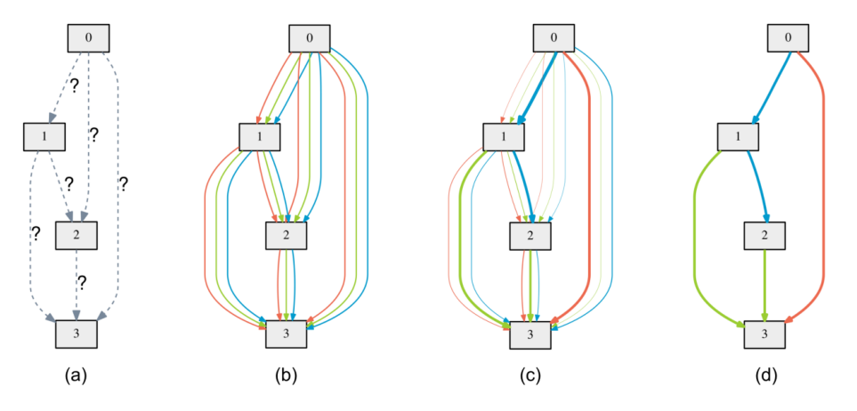
1. Summary
Define Search space as DAG(Directed Acyclic Graph)
Notes:
3

Slide 4
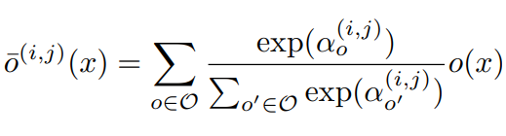
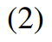
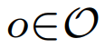
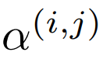
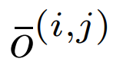
1. Summary
Example of a set O : {convolution, pooling, none}
: Weights of operations (Vector)
: Mixed operation
Notes:
4

Slide 5
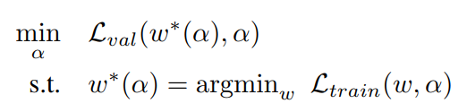
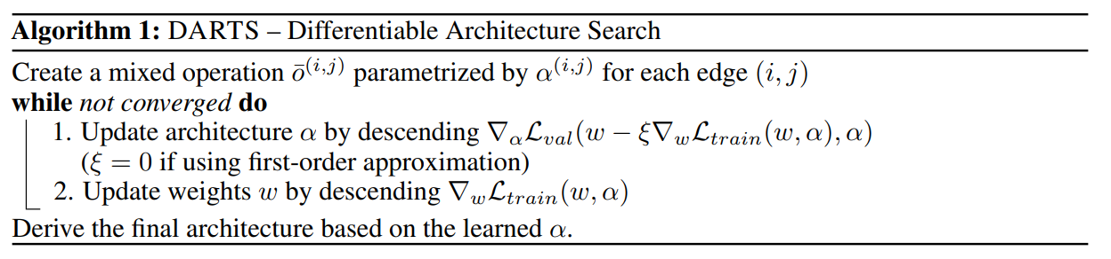
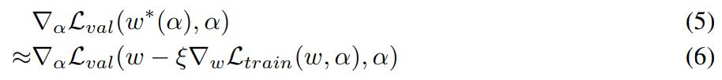
1. Summary
Loss to optimize is w of train loss and α (weight of operation) of validation loss
Notes:
5

Slide 6
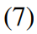
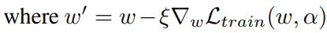
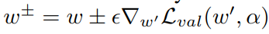
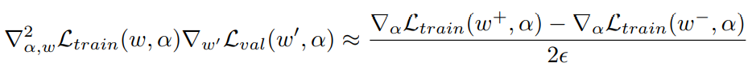
2. Approximation
Simple approximation
Applying chain rule to the approximate architecture gradient
Finite difference approximation
Notes:
6

Slide 7
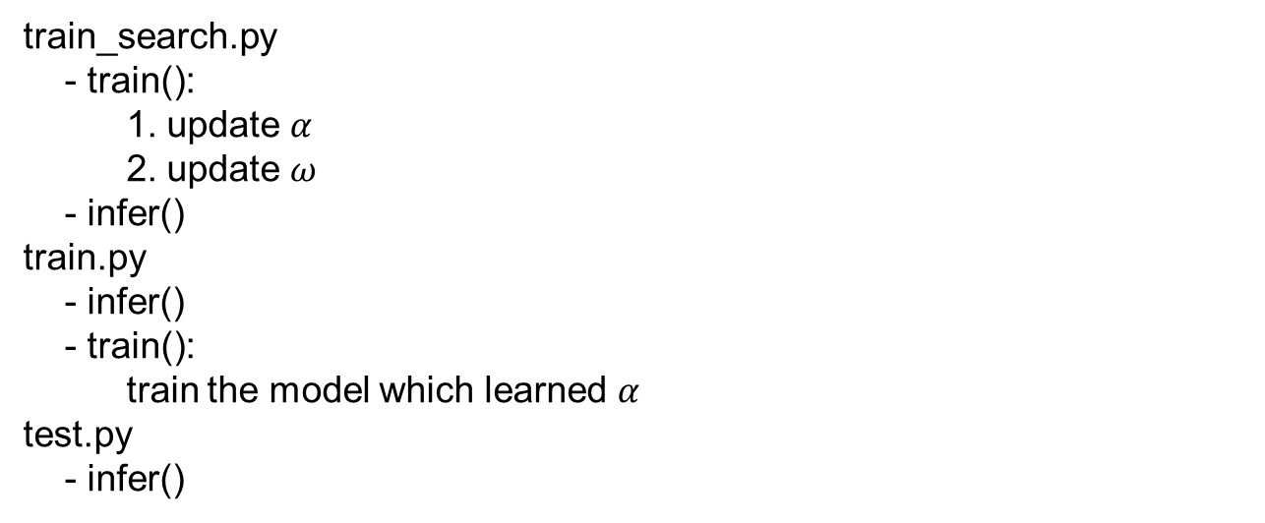
3. Code Analysis
train_search.py
- train():
1. update $α$
2. update $ω$
- infer()
train.py
- infer()
- train():
train the model which learned $α$
test.py
- infer()
Notes:
7

Slide 8
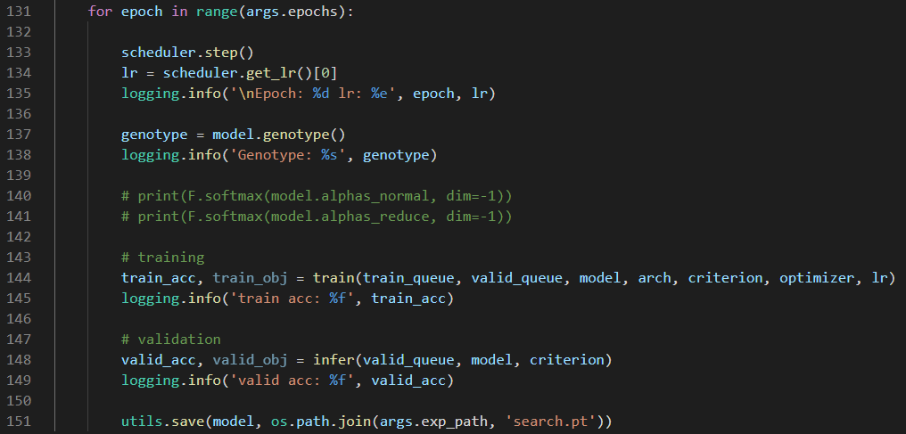
3. Code Analysis
train_search.py
Notes:
8

Slide 9
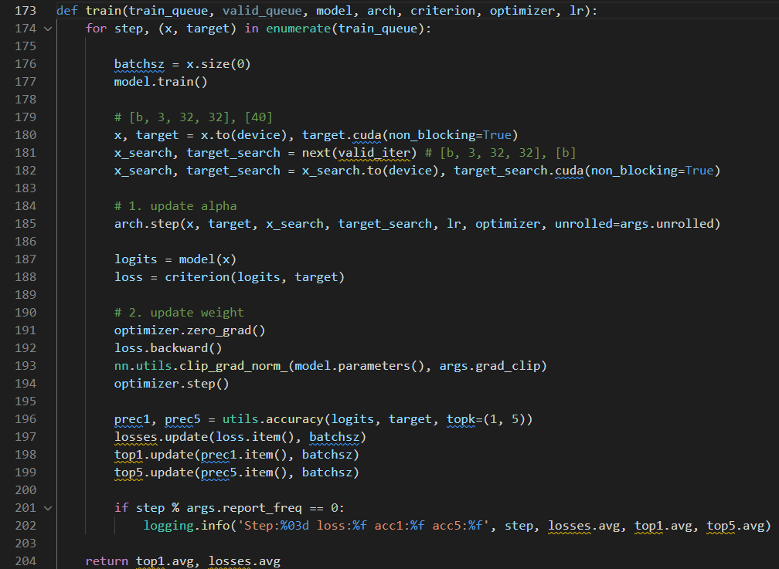
3. Code Analysis
train_search.py
Notes:
9

Slide 10
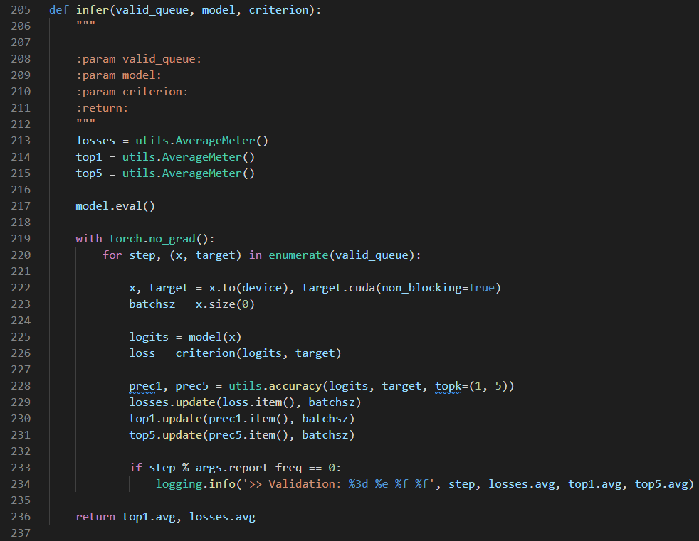
3. Code Analysis
train_search.py
Notes:
10

Slide 11
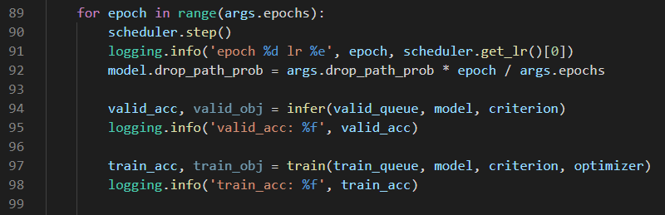
3. Code Analysis
train.py
Notes:
11

Slide 12
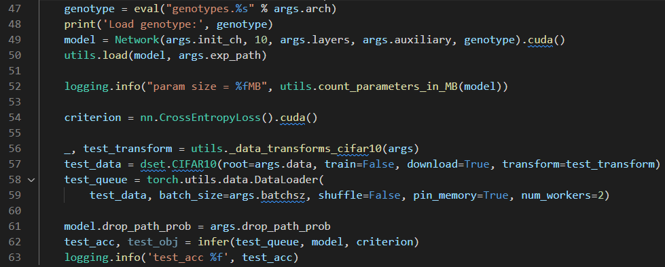
3. Code Analysis
test.py
Notes:
12

Slide 13
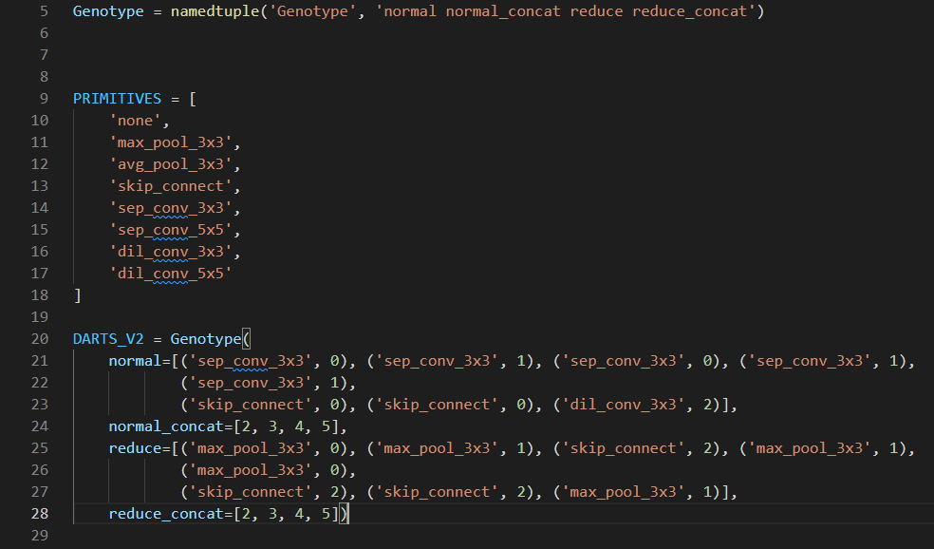
3. Code Analysis
Genotype
Notes:
13

Slide 14
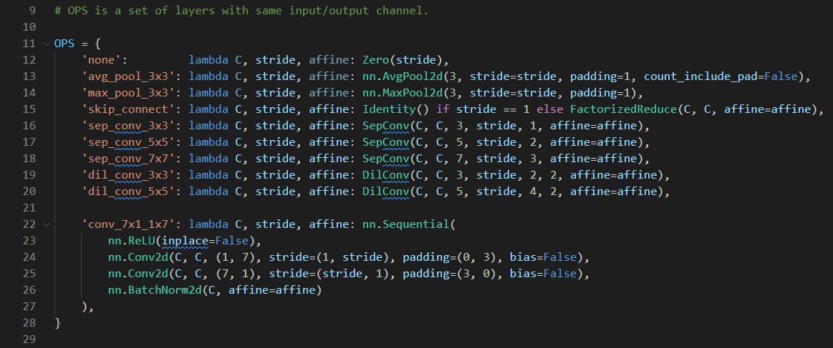
3. Code Analysis
Operators
Notes:
14

Slide 15
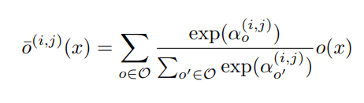
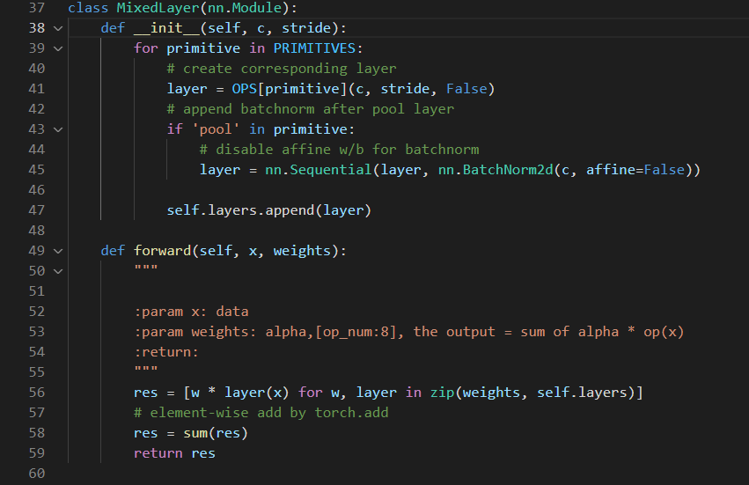
3. Code Analysis
Notes:
15

Slide 16
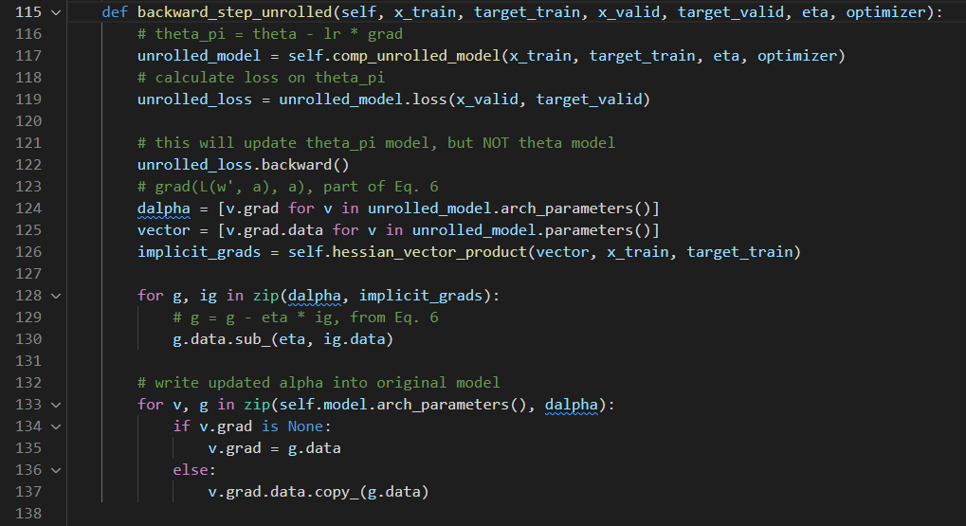
3. Code Analysis
Notes:
16

Slide 17
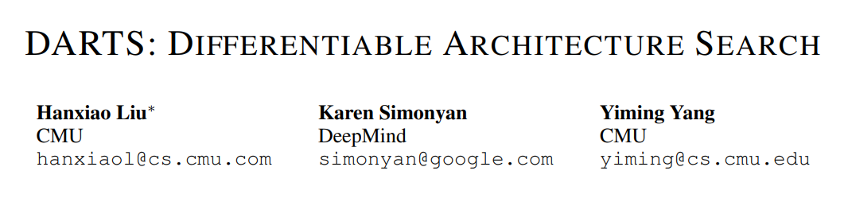
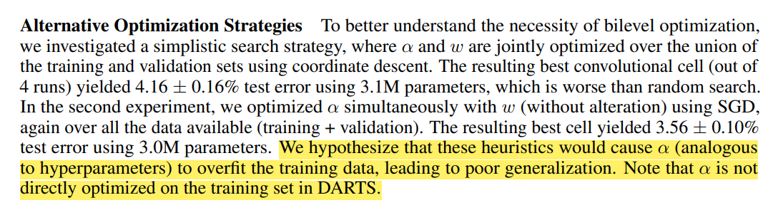
4. Problems Discussed
Notes:
17

Slide 18
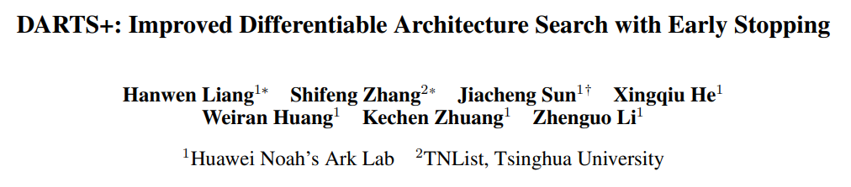
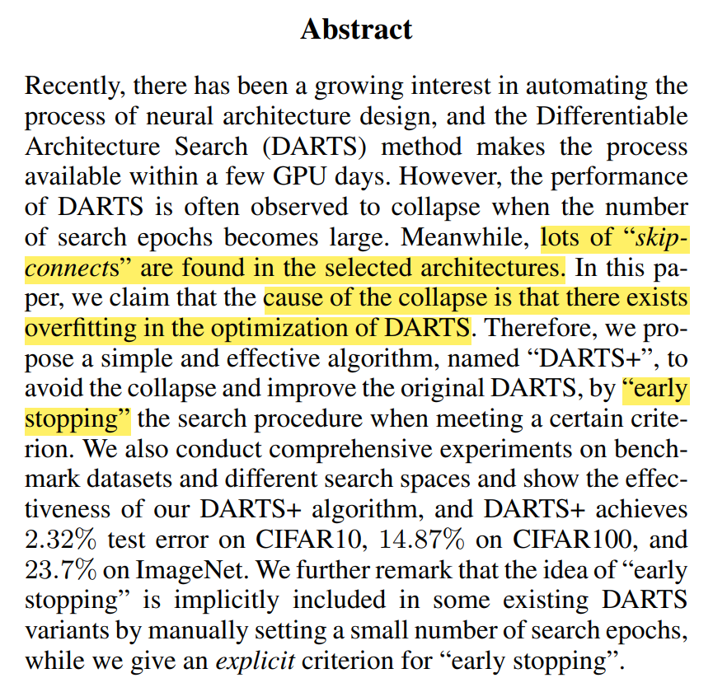
4. Problems Discussed
Notes:
18

Slide 19
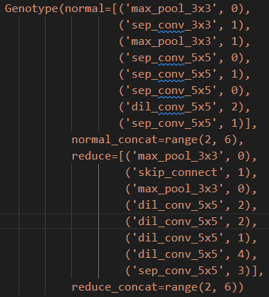
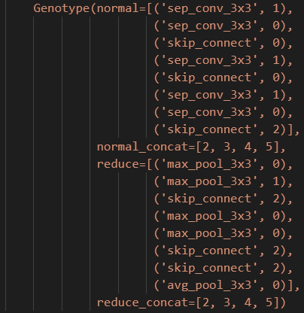
4. Problems Discussed
Extreme case)
After 1st epoch
After 50th epoch
Notes:
19

Slide 20
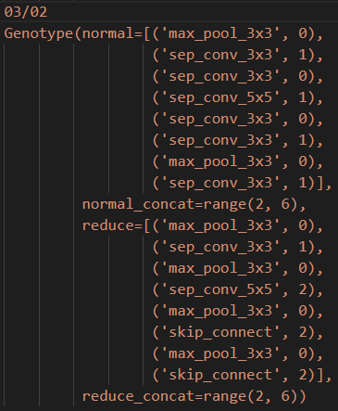
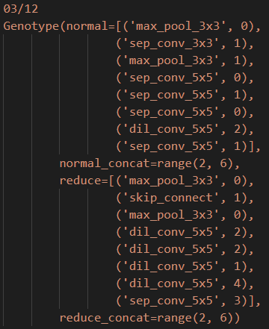
4. Problems Discussed
Common case)
After 50th epoch
After 50th epoch
Notes:
20

Slide 21
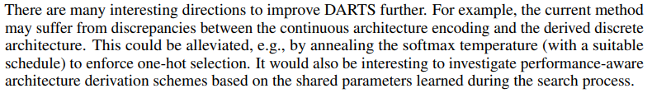
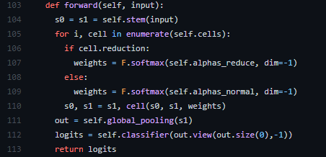
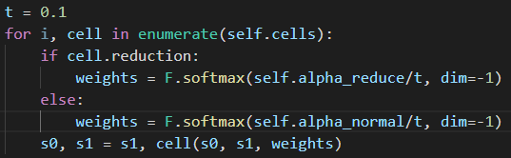
5. Research Progress
Notes:
21

Slide 22
5. Research Progress
Results so far
Trials | Test accuracy(%)
Original code 1 | 95.93
Original code 2 | 96.08
Original code 3 | 96.01
Original code 4 | 96.11
Average of Original code | 96.03
Temperature Anealing (t=0.1) | 96.27
Temperature Anealing (t=0.1) | On going
Gumbel Softmax trick | On going
Notes:
22

Slide 23
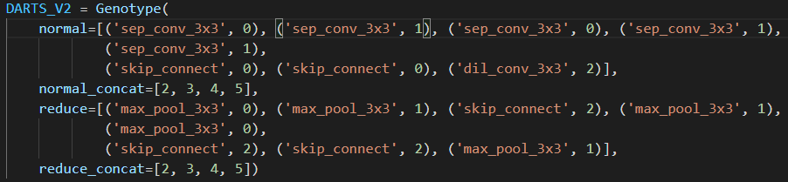
6. Conclusion and Discussion
이러한 결과는 기존의 Neural Architecture Search 문제를 제기하고 해결한
NAS, ENAS등의 유명 논문들이 채용한 문제 세팅을 DARTS에서도 그대로 채용하였기 때문에 softmax만으로는 충분한 continuous relaxation을 이끌어내지 못했기 때문이라고 사료됨.
Notes:
23

Slide 24
References
https://arxiv.org/abs/1806.09055
https://github.com/quark0/darts
https://github.com/dragen1860/DARTS-PyTorch
https://arxiv.org/abs/1909.06035
https://arxiv.org/abs/1905.01786
https://arxiv.org/abs/1611.01144
Notes:
24

Slide 25
감사합니다.
Q & A
25
Notes:
-
The training of procedure for is to maximize the probability of D making a mistake. This framework corresponds to a minimax two-player game.
In the space of arbitrary functions G and D, a unique solution exists, with G recovering the training data distribution and D equal to ½ everywhere.
25

Slide 26
6. Conclusion and Discussion
이러한 결과는 기존의 Neural Architecture Search 문제를 제기하고 해결한
NAS, ENAS등의 유명 논문들이 채용한 문제 세팅을 DARTS에서도 그대로 채용하였기 때문에 softmax만으로는 충분한 continuous relaxation을 이끌어내지 못했기 때문이라고 생각함. 8가지 operation이 아닌, 10만개 정도의 operation이 있다면 어느정도 충분한 relaxation이 가능할 것으로 예상되나, 이는 목적에 맞지 않는 불필요하게 너무 많은 operation일 수 있다.
Notes:
26

Slide 27
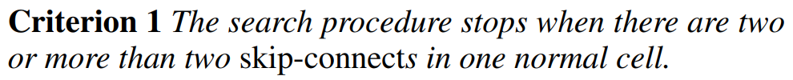
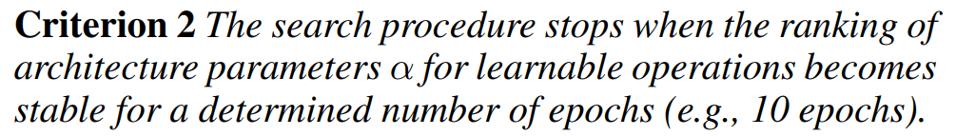
4. Conclusion and Discussion
Notes:
27

Slide 28
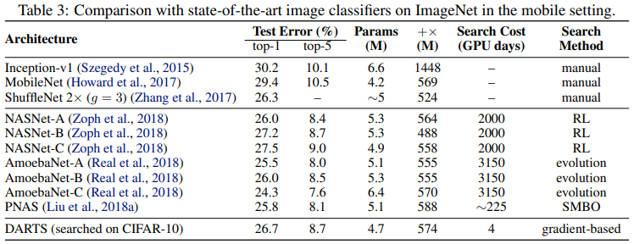
4. Results
Transfer learning with DARTS
Notes:
28

Slide 29
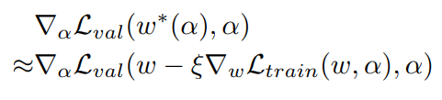
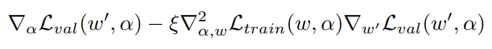
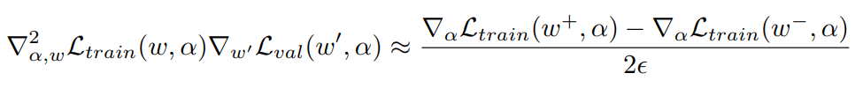
1. Summary
Approximation that significantly reduces search cost
Notes:
29

Slide 30
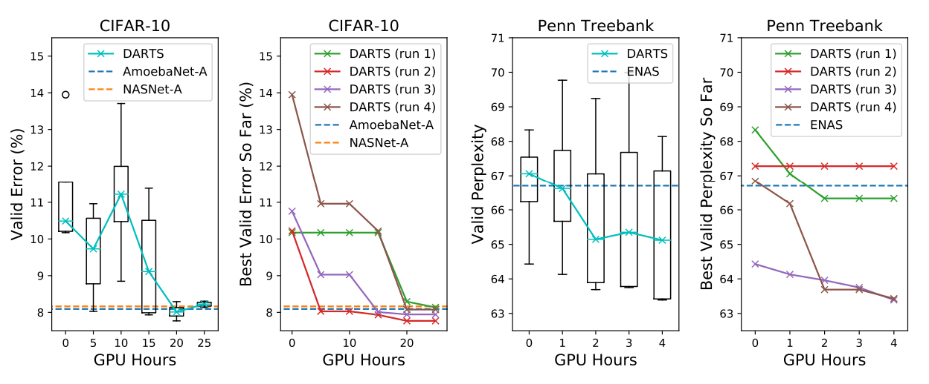
1. Summary
As a result, it outperforms other SOTA algorithms
Notes:
30

Slide 31
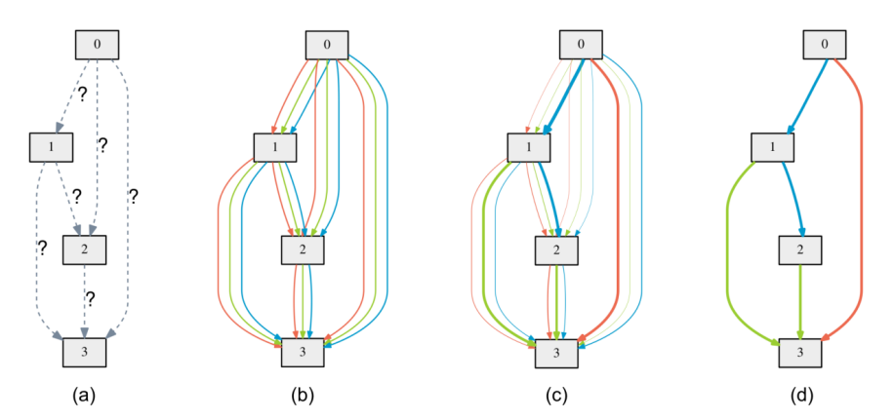
2. Search space
Directed Acyclic Graph
Notes:
31

Slide 32
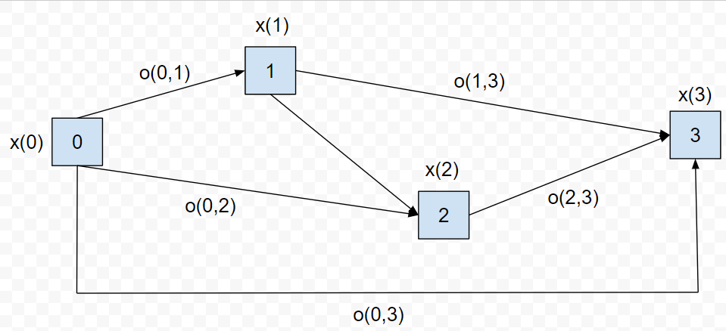
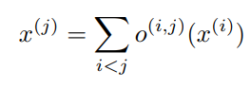
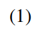
2. Search space
Directed Acyclic Graph
x(i) : input
x(j) : output
o(i,j) : operation (transforms x(i))
Notes:
32

Slide 33
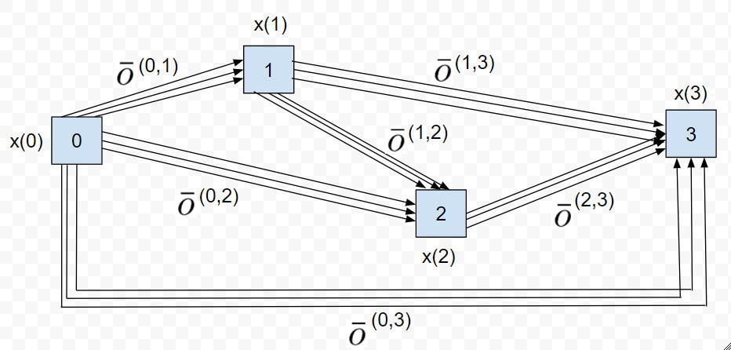
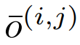

3. Continuous relaxation and optimization
The task of architecture search then reduces to learning a set of continuous variables α = { α (i,j) }
At the end of the search, replace
with
Notes:
33

Slide 34





3. Continuous relaxation and optimization
: weight one step after w
Goal is to find α* that minimizes
(4) is bilevel optimization problem
Notes:
34

Slide 35


4. Approximation
: Learning rate for a step of inner optimization
Notes:
35

Slide 36

4. Results
The example shows that a suitable choice of ξ helps to converge to a better local optimum.
Notes:
36

Slide 37
5. Conclusion
Optimization gap
discrepancies between the continuous architecture encoding and the derived discrete architecture.
This could be alleviated by annealing the softmax temperature (with a suitable schedule) to enforce one-hot selection.
Performance-aware architecture derivation schemes based on the shared parameters learned during the search process.
Notes:
37

